Slide 1
Encounters with jesus
John 5 1 - 15

Slide 2
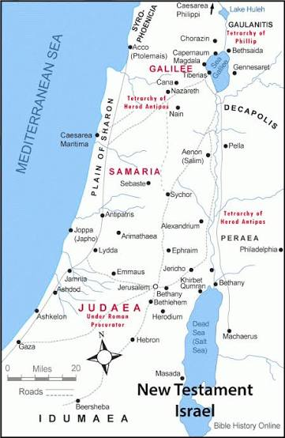

Slide 3
What do we know about the man?
What do we learn about Jesus?
Who else was impacted by what went on at the pool?
Why did Jesus ask him ‘that’ question?
What can we learn from this encounter?

Slide 4
Is there anything
I need to do now?

